Slide 1


Abstra
Lazar Milicevic
Weekly support report
Support, Challenges, Sollutions
24.07.2025

Slide 2
Agenda
1. Operational & Reporting Highlights
3. Report Delivery & Ticket Metrics
5. KPIs & Next Steps
2. Technical Support & Escalations
4. PostHog Integration (Phase 1)
6. Q&A

Slide 3
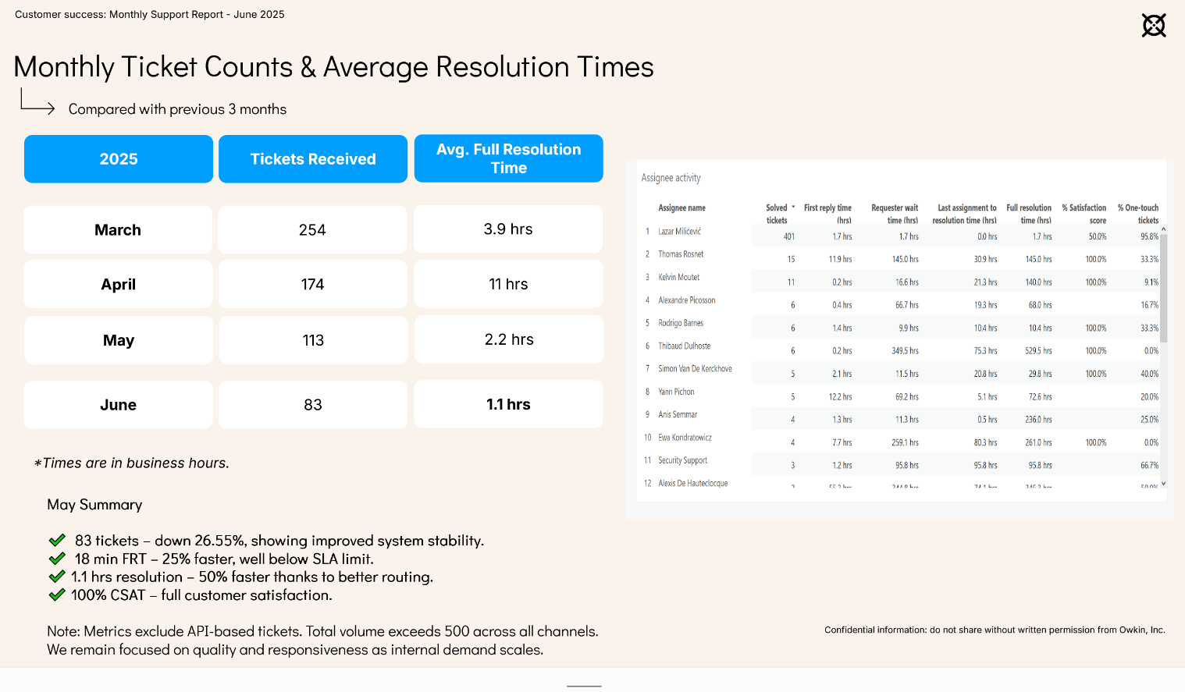
Operational & Reporting Highlights
Customer success: Weekly Support Report – 24.07.2025
Where we are now ?
Zendesk Operations
Managed weekly agent rotation for consistent ticket coverage.
SLA target: 2h → maintained avg. first response under 30 minutes.
Took lead on triaging all K and Abstra tickets.
Signup Metrics Automation
Daily Python script generates K signup reports.
Enhanced with tabs: Tickets, Weekly Summary, Approved/Rejected, High-Value Leads.
Report archive:
👉 K Signup Reports
Area | Tickets | Share
Owkin K | 515 | ~55%
Abstra | 427 | ~45%

Slide 4
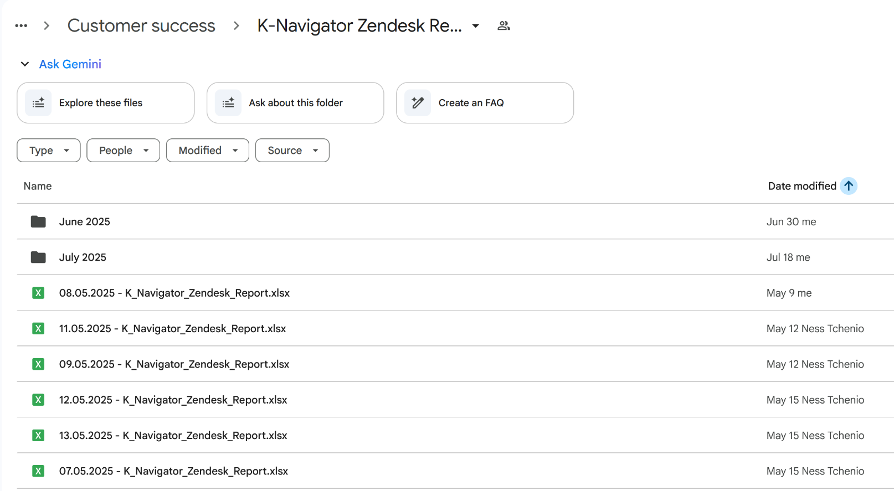
Technical Support & Escalations
Customer success: Weekly Support Report – 24.07.2025
Some of them:
L2 Issue Resolution
Directly resolved:
VPN setup & WireGuard issues
Access failures & login problems
Domain whitelisting & certificate errors
Network and connectivity edge cases
Live Support & Onboarding
Guided external users (e.g. Hackathon teams, MOSAIC) via Slack and Google Meet.
Ensured smooth onboarding and config delivery.

Slide 5

Report Delivery & Ticket Metrics
Customer success: Weekly Support Report – 24.07.2025
Report Sharing
Distributed signup and customer reports to Ness, Adrien, and other stakeholders.
Tailored views for Product, Strategy, and Support.
Ticket Breakdown (Apr–Jul 18)
Product | Tickets | Share
Owkin K | 515 | 55%
Abstra | 427 | 45%
K tickets: Signup & access
Abstra: Infra support & onboarding
👉 Monthly Reports Drive

Slide 6
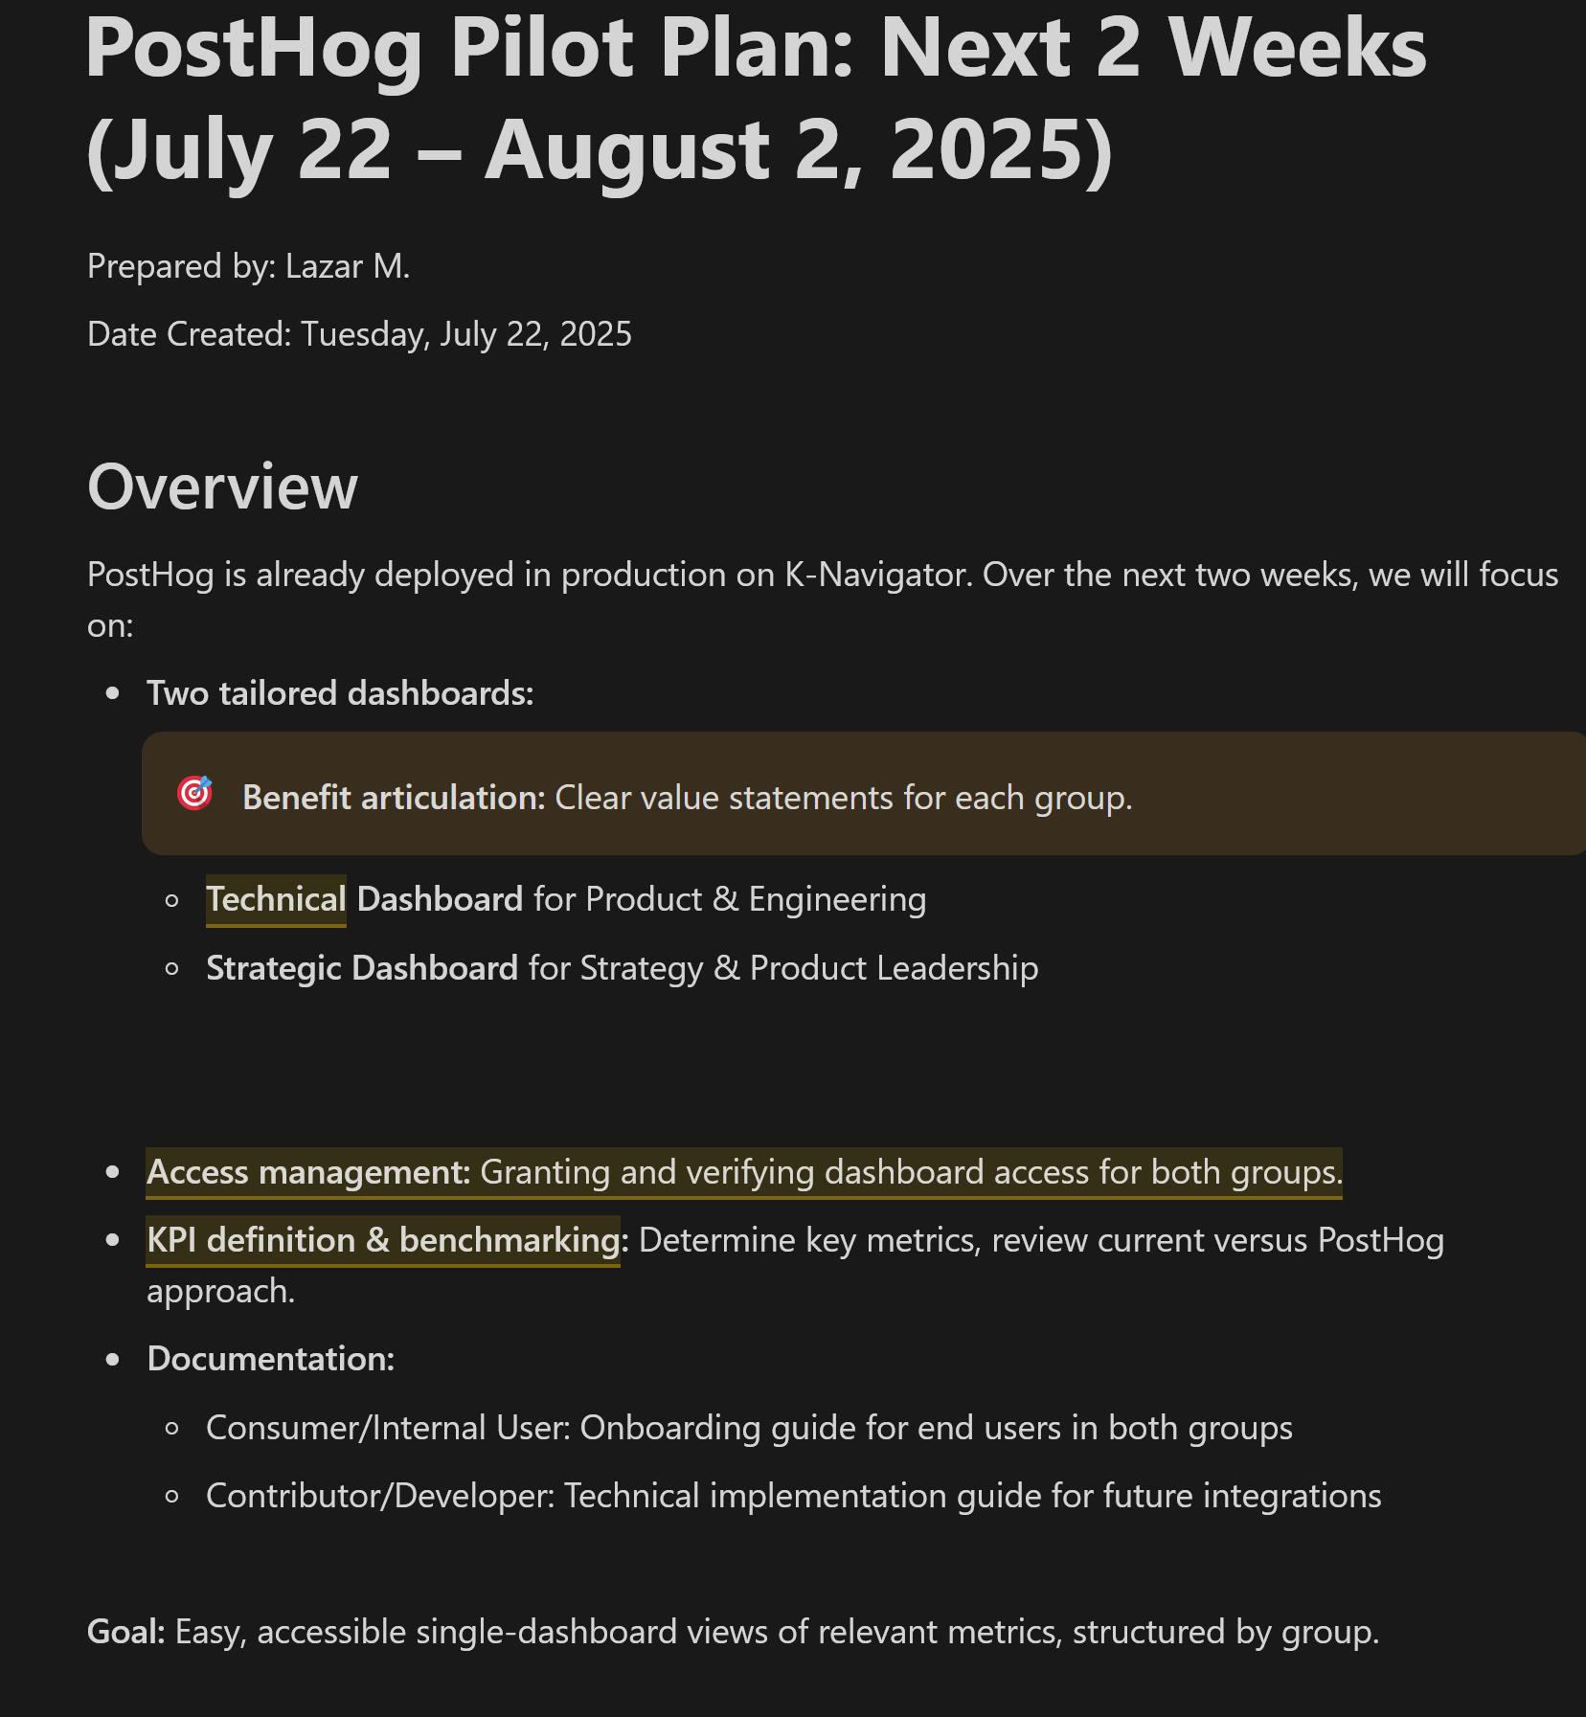
PostHog Integration (Phase 1)
Customer success: Weekly Support Report – 24.07.2025
Setup & Dashboard Creation
Collaborated with Adrien to integrate PostHog into K-Navigator frontend.
Created 2 dashboards:
DevOps Insights (Engineering)
Strategy Pulse (Product Leadership)
Access Setup
Added all users manually due to free plan limitations.
Analytics Events Defined:
autocapture,
rageclick,
signup_successful,
web vitals, etc.

Slide 7
KPIs & Next Steps
Customer success: Weekly Support Report – 24.07.2025
?
KPI Mapping from FullStory → PostHog
🟦 Strategy Dashboard:
DAU / WAU / Retention
Funnel Completion
Device/Country breakdown
Chat history analysis
🟩 Engineering Dashboard:
Session metrics
Rage/Error clicks
Web Vitals (LCP, CLS)
Heatmaps & feature flags
Next Steps
Finalize dashboards & launch pilot testing
Run UX validation with Adrien (Week 2)
Continue report exports + monitor FullStory for K funnel optimization
The plan of implementation: Here

Slide 8

Q&A
Customer success: Weekly Support Report – 24.07.2025
?

Slide 9
Thank you!

